Slide 1
CH2 Algorithm Performance Basics

Slide 2

Agenda
Data Structures
Characteristics
Need for Data Structures
Algorithm Basics
Characteristics
Space Complexity
Time Complexity
Performance Basics
Analyzing Performance
The Big O Notation
Image: Pixabay

Slide 3

1. Data Structures
A systematic way to organize data in order to use it efficiently!
Interface
Interface represents the set of operations that a data structure supports.
Implementation
Implementation provides the internal representation of a data structure. Implementation also provides the definition of the algorithms used in the operations of the data structure.
Image from Pixabay

Slide 4

1.1. Characteristics
Correctness
Data structure implementation should implement its interface correctly.
Time Complexity
Running time or the execution time of operations of data structure must be as small as possible.
Space Complexity
Memory usage of a data structure operation should be as little as possible.
Image from Pixabay

Slide 5

2. Algorithm basics
Algorithm = a step-by-step procedure, which defines a set of instructions to be executed in a certain order to get the desired output
Important caregories of algorithms:
Search
Sort
Insert
Update
Delete
Image from Pixabay

Slide 6
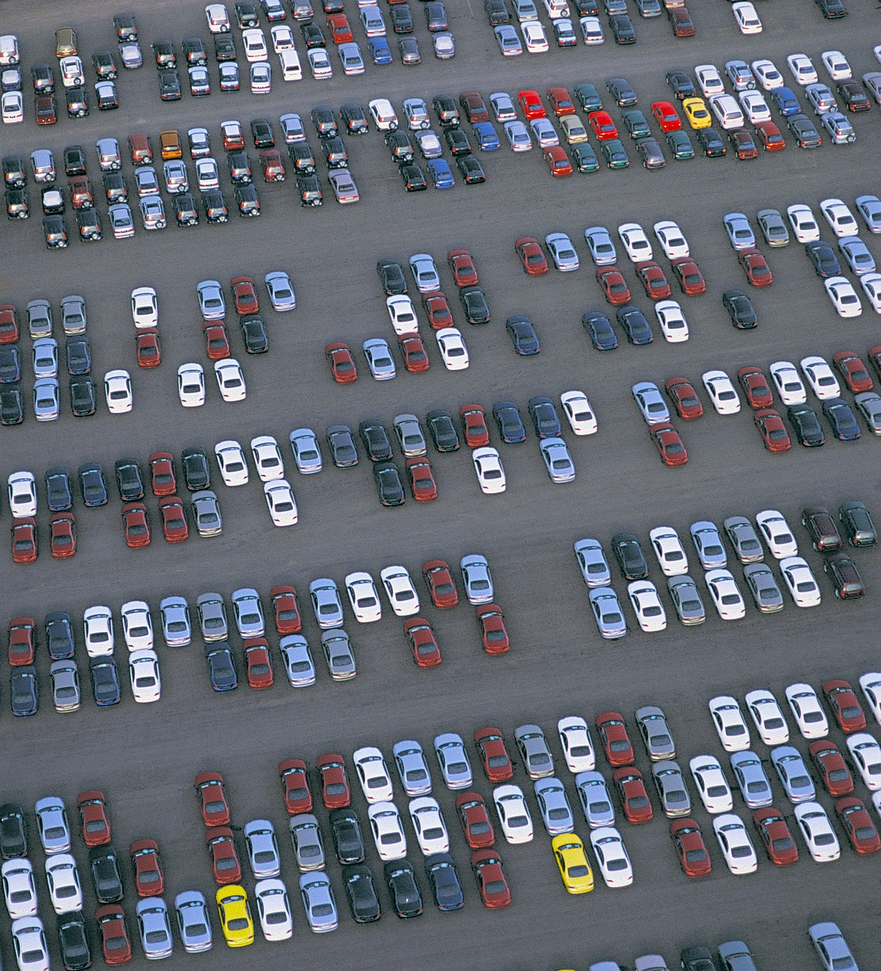
2.1. Characteristics
An algorithm should have the following
Characteristics:
Unambiguous (clear interpretation)
Input
Output
Finiteness
Feasibility (doable)
Independent
Image source: Pixabay
Image: Pixabay
Image: Pixabay
Image from Pixabay

Slide 7
Algorithm Example
Problem − Design an algorithm to add two numbers and display the result.
step 1 − START
step 2 − declare three integers a, b & c
step 3 − define values of a & b
step 4 − add values of a & b
step 5 − store output of step 4 to c
step 6 − print c
step 7 − STOP
Algorithms tell the programmers how to code the program!
Alternatively:
step 1 − START ADD
step 2 − get values of a & b
step 3 − c ← a + b
step 4 − display c
step 5 − STOP

Slide 8

2.2. Space Complexity
= The amount of memory space required by the algorithm in its life cycle!
Fixed part
space required to store certain data and variables, that are independent of the size of the problem (var, const etc.)
Variable part
space required by variables, whose size depends on the size of the problem (dynamic memory allocation, stack etc.)
Image source: Pixabay
Image: Pixabay
Image: Pixabay
Image from Pixabay

Slide 9
2.2. Space Complexity pt. 2
Space complexity S(P) of any algorithm P is S(P) = C + SP(I), where C is the fixed part and S(I) is the variable part of the algorithm, which depends on instance characteristic I.
Example Algorithm: S(P) = 1 + 3
SUM(A, B)
Step 1 - START
Step 2 - C ← A + B + 10
Step 3 - Stop
Image source: Pixabay
Image: Pixabay
Image: Pixabay
Image from Pixabay

Slide 10
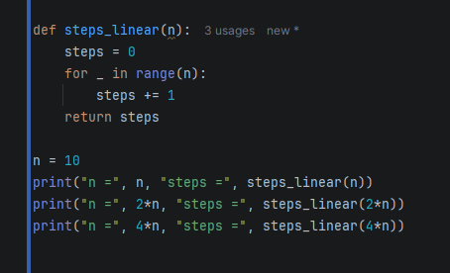
2.3. Time Complexity
= The amount of time required by the algorithm to run to completion.
T(n) – Measured as number of steps
For example:
Addition of two n-bit integers takes n steps. Consequently, the total computational time is T(n) = c*n, where c is the time taken for the addition of two bits.

Slide 11

2.3. Performance Basics
Important to know how “fast” a program runs.
Hardware matters.
Deciding what algorithm to use is very important to all programmers!
Trade off between speed and memory usage
Programmer has to find the balance and decide!
Image from Pixabay

Slide 12

3. Analyzing Performance:
Big O Notation
A mathematical function that shows how much time or space use is going to be needed at worst given different input sizes.
f(n) = c -> O(1), constants can be disregarded
Image source: Pixabay
Image: Pixabay
Image: Pixabay
Image from Pixabay

Slide 13
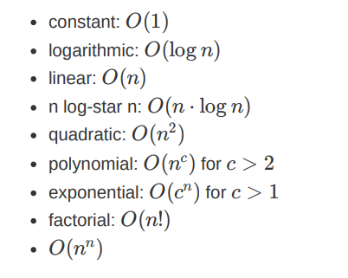
3. Analyzing Performance:
Big O Notation pt 2
A simple list of big O notations for algorithms.
Fastest algorithm is one with O(1) and the slowest one is an algorithm with O(n^n).
When we have different algorithms to solve a problem, we can compare them by their big O notations.
Image source: Pixabay
Image: Pixabay
Image: Pixabay
Image from Pixabay

Slide 14
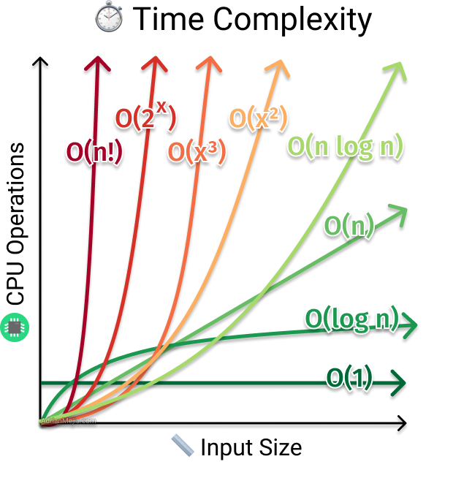
3. Analyzing Performance:
Big O Notation pt 3
Big O is just a way to represent time complexity or space complexity
Notice the small values of n (small input sizes)! The order can be different.

Slide 15
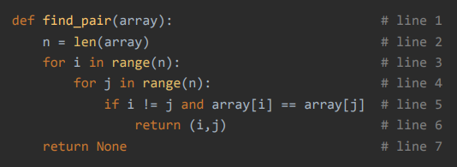
3. Analyzing Performance:
Big O Notation pt 4
<- Example!
Worst case is pair not found
Take the highest polynomial factor!
f(n) = c * n^2 + d
Big O for this algorithm is?
c = time for each iteration. constant
d = operations (lines 2 & 7). constant
n = size of array

Slide 16
Time for exercises!
tino.kankkunen@metropolia.fi

